Slide 1
x

Slide 2
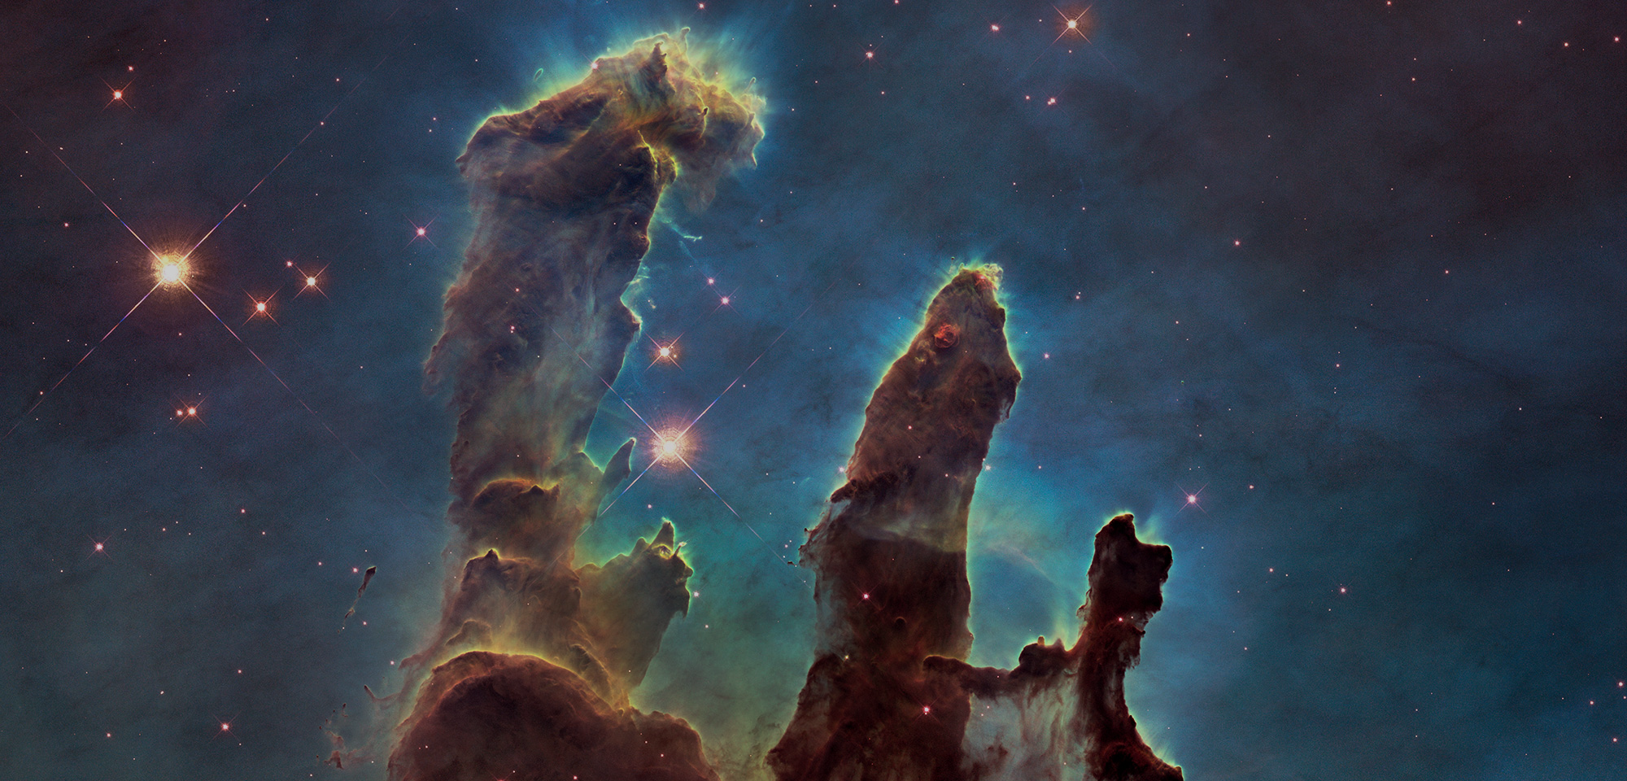
“God created”

Slide 3
God created all things
(Genesis 1:1)
God created

Slide 4
All things persist due to a creative God
(Genesis 1:11-24; Psalm 139:13-16)
God created

Slide 5
The nation of Israel was created
(Isaiah 43:1)
God created

Slide 6
The church was created by God
(Ephesians 2:19-22; I Peter 2:9-10)
God created

Slide 7
Individual Christians are new creations
(II Corinthians 5:17)
God created

Slide 8
We look forward to new heavens and earth
(II Peter 3:10-13)
God created

Slide 9
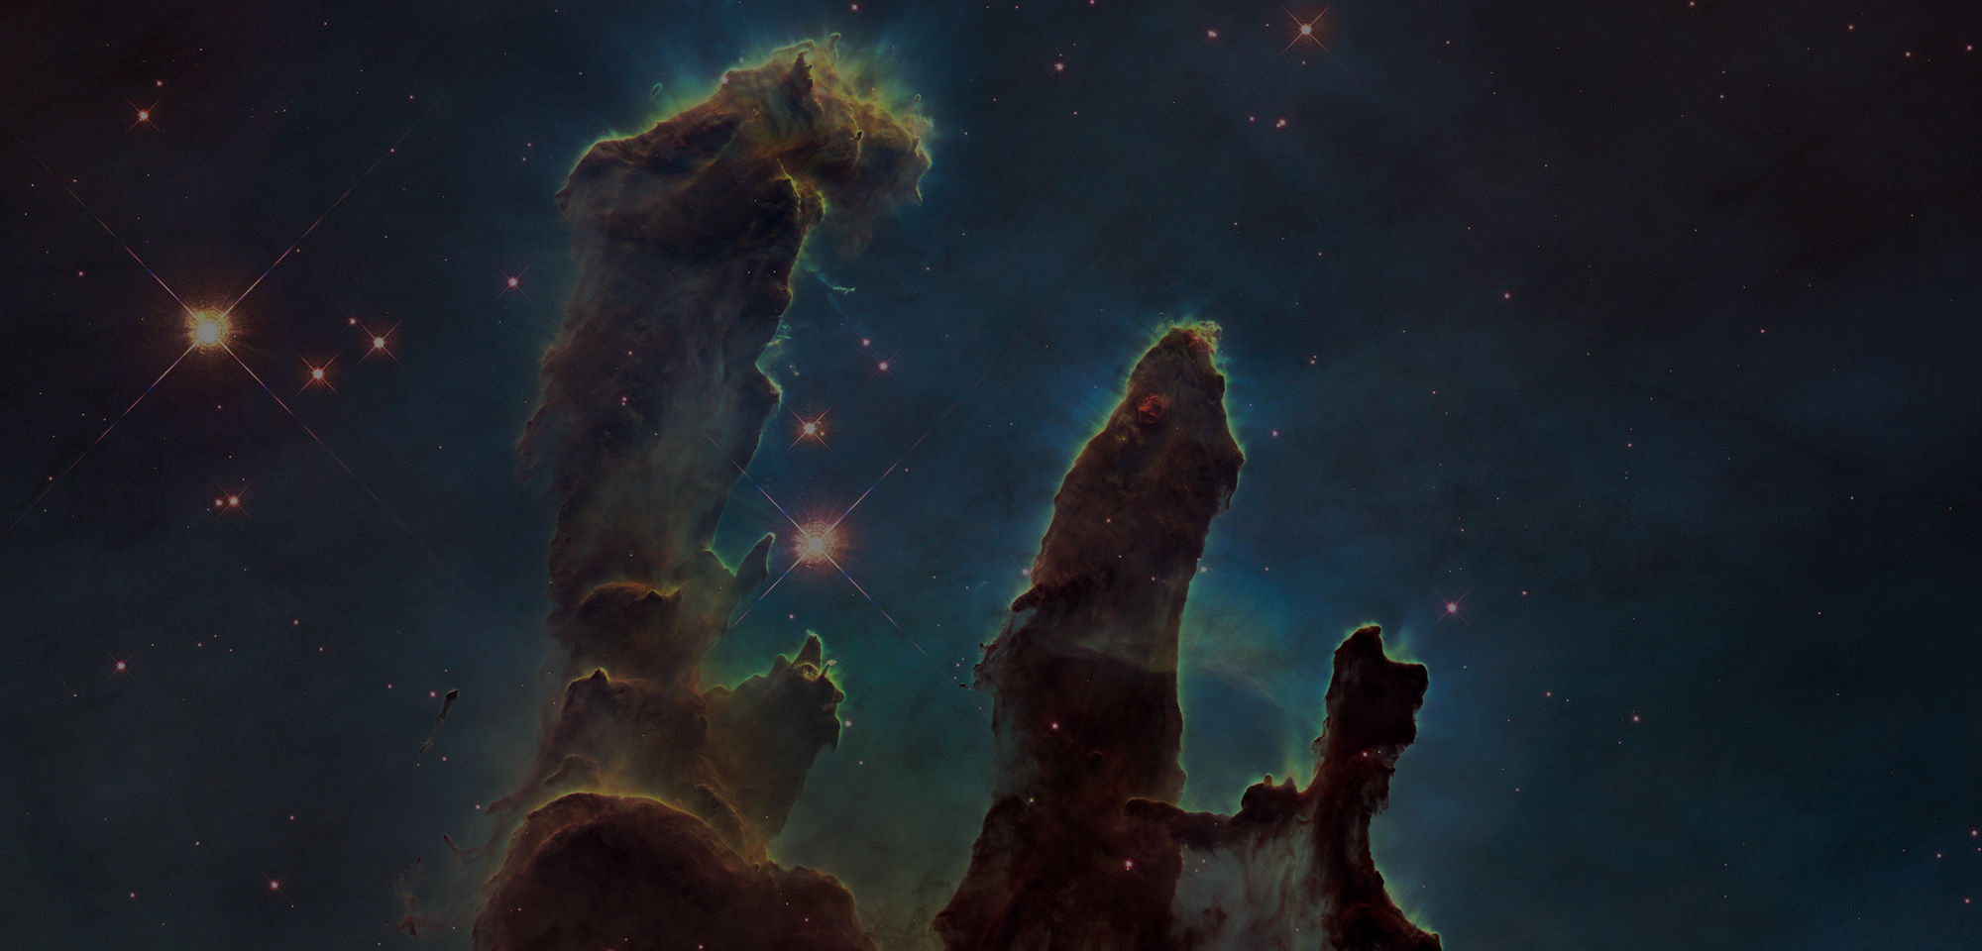
Conclusions
Life is found only in God
Your purpose is defined by God
We benefit from the grace of God
God created

